Slide 1


Advanced Hybrid Recommendation Architectures: From Latent Space to Deployment
This presentation summarizes an M2 Data Analytics for Business project. Combined Score: 24.18%.
Notes:
1

Slide 2
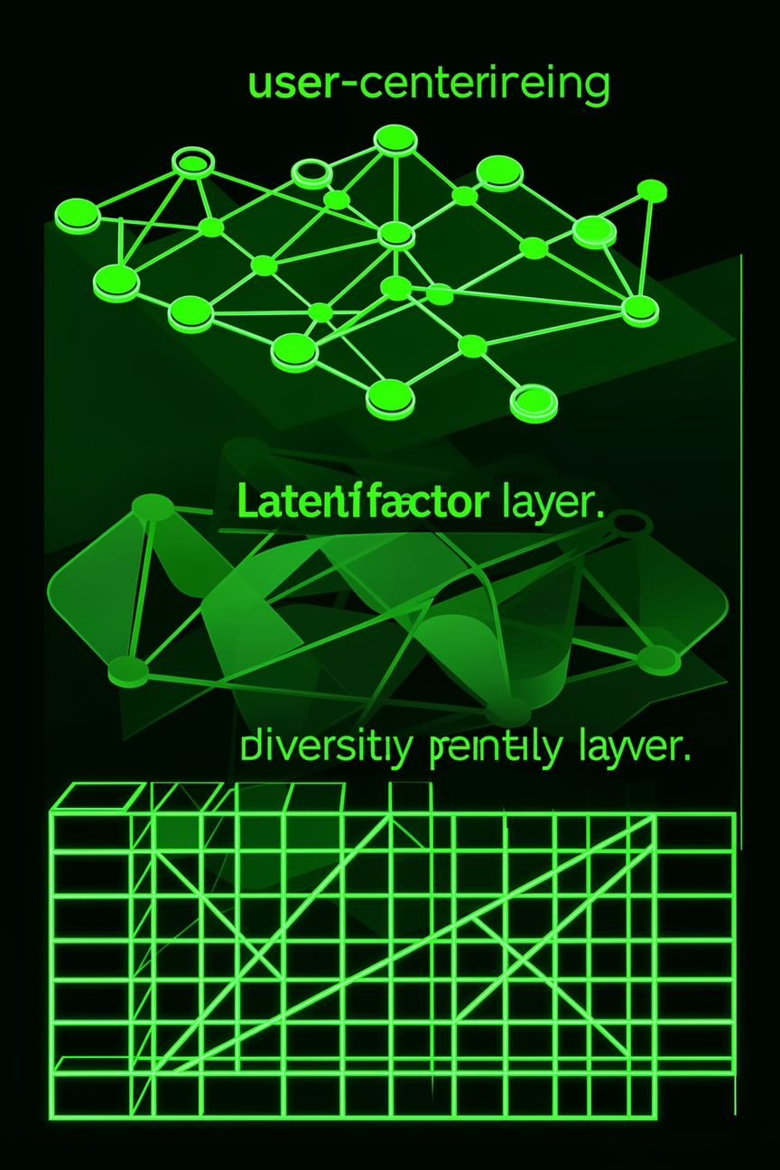
Architectural Foundation — The 3‑Layer Hybrid
Layer 1 — User Centering
Layer 2 — Latent Factor Engine
Normalizes rating distributions per user to remove personal bias before scoring.
Truncated SVD mapping 60 latent factors to reveal hidden relations between tastes and movie features.
Layer 3 — Diversity Penalty
Applies a 0.11 diversity penalty to final rankings to increase catalog coverage and novelty.
Simultaneous scoring combines the three layers to produce balanced, diverse recommendations.
Notes:
2

Slide 3
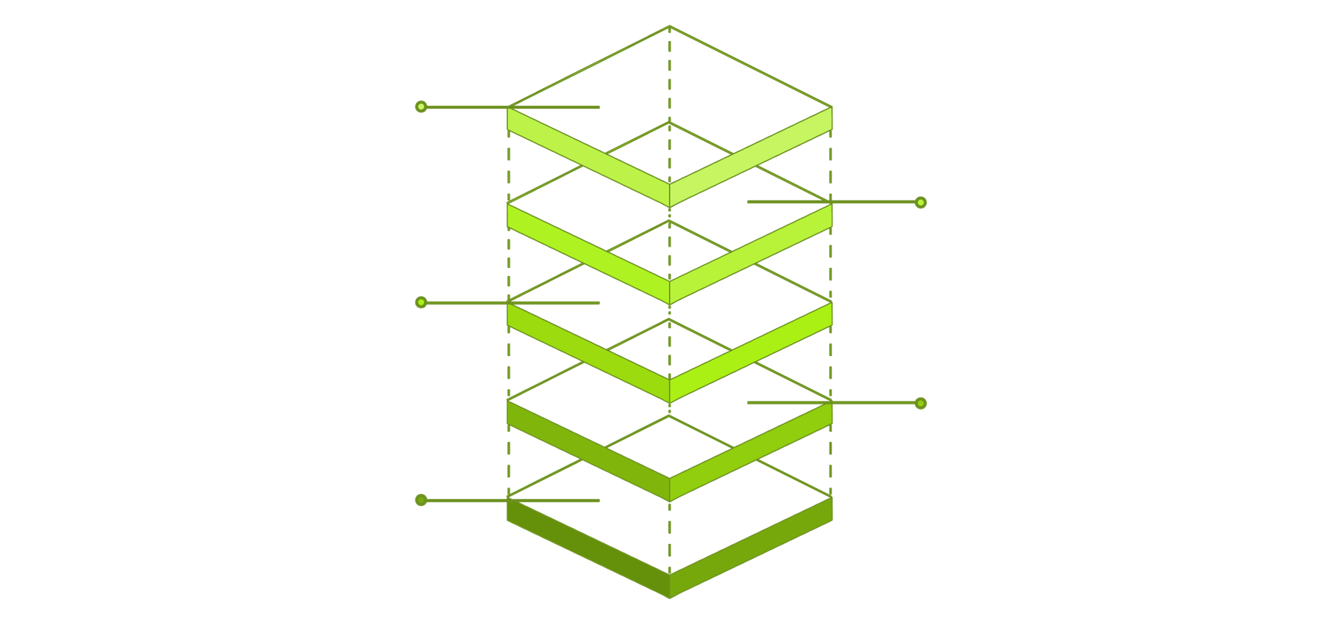
Deep-Dive: The Latent Factor Engine (SVD)
Reconstruct & Minimize Error
Rebuild matrix and reduce loss
60 Latent Components
Optimize factors with float32
Decompose into Vᵀ
Item latent features
Decompose into U
User-Item Matrix
User latent preferences
Sparse interactions matrix
Matrix Factorization decomposes the sparse User-Item matrix into U and V^T. We optimize 60 latent components to capture complex genre intersections while controlling overfitting. Use float32 precision to reduce memory footprint for limited-RAM high-performance processing.
Notes:
3

Slide 4
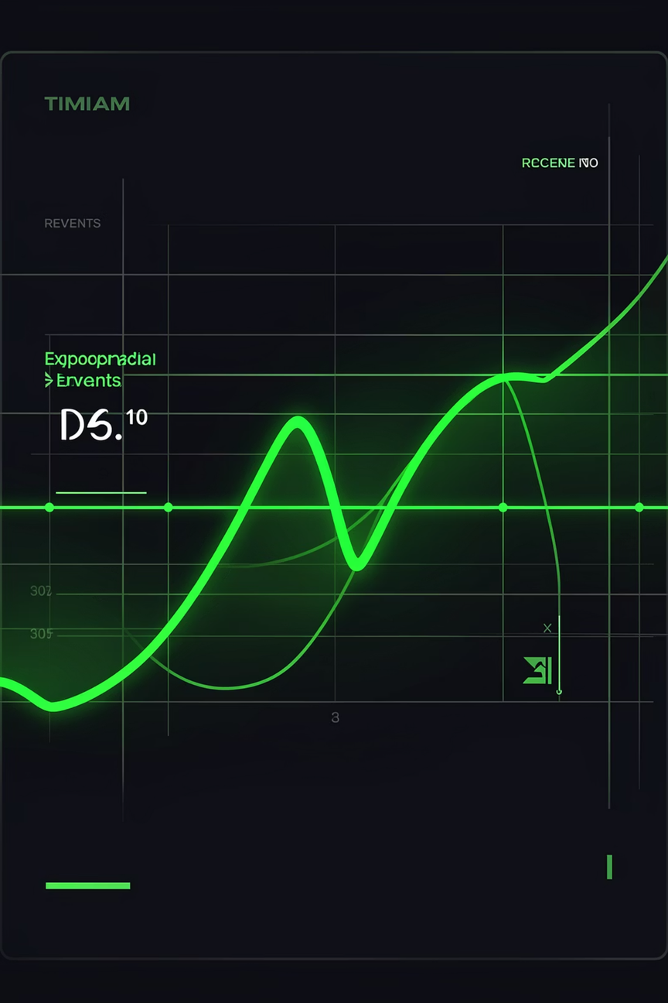

Temporal Intelligence & Recency Weights
Exponential Decay (Half-Life)
Assigns higher weight to recent interactions via an exponential decay function.
Solving Frozen Profiles
Prioritizes current interests so stale historical data doesn't dominate recommendations.
Integrated in Training
Decay weights are applied during model training to adjust each rating's influence by age.
Result: recommendations reflect evolving user tastes with temporal sensitivity.
Notes:
4

Slide 5

The Deployment Pivot — Solving ALS Environment Crash
Problem
Binary incompatibility between NumPy builds in Python 3.12 caused the original ALS model to crash on the evaluator.
Approach
Implemented a Closure Factory wrapper that precomputes recommendations into a lightweight dictionary.
Result
Zero-dependency artifact using cloudpickle for stability; evaluator performs dictionary lookups instead of fragile matrix math.
Notes:
5

Slide 6
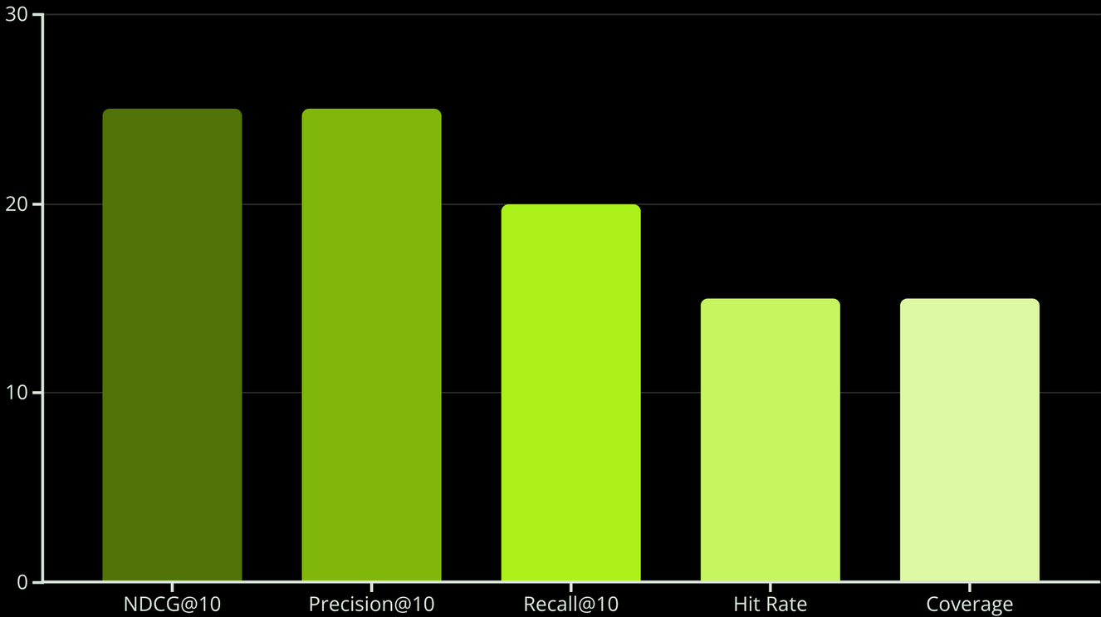
Validation, Metrics & Performance
Evaluation Protocol
Temporal split: 80/20 train/test with a leakage diagnostic to ensure future data isn't used in training.
Combined Score
The model achieved a Combined Score of 24.18% computed from the weighted metrics shown in the chart.
Business Impact
This hybrid approach improves novelty and retention, making it a superior tool for long-term user engagement.
Notes:
6

Slide 7

Conclusions & Next Steps
Robust Hybrid Design
Operational Stability
Three-layer simultaneous scoring balances personalization, latent structure, and diversity.
Closure Factory + cloudpickle yields a zero-dependency deployment resilient to environment mismatches.
Future Work
Refine decay half-life, experiment with alternative diversity coefficients, and scale evaluation across live A/B tests.
Contact: M2 Data Analytics for Business — project brief available on request.
Notes:
7

